Slide 1

Predicting Forex Price
(EUR/USD)

Slide 2
Outline
1. Business Problem
2. Task for Time Series
3. Data
4. Models:
● ARIMA
● RNN-LSTM
● Prophet
5. Summary

Slide 3

Introductory
Predicting how the Forex market going is one of the hardest things to do (than the Stock market). Stock trading involves buying and selling shares of individual companies, whereas forex trading involves exchanging – buying and selling simultaneously – cash minted by two different countries. ... Stock trading is best when markets are rising, since low liquidity makes it difficult to short sell in falling markets.

Slide 4
Data acquisition and cleaning
● The Forex Exchange(finance.yahoo.com/currencies) financial newspaper(cafef,vietstock...), Stock brokerage((Fxpro, Exness, IC Markets…), github package (fxcmpy, alphavantage)...
● In total, 3235 rows and 5 features for the ‘EUR/USD’ alone
●The data from the: https://github.com/fxcm/RestAPI pretty clean =>No duplicate, highly similar or highly correlated features.
● Cleaned data contains 5 features.

Slide 5
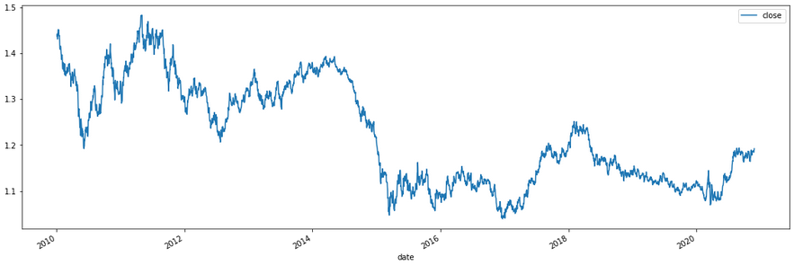
Would you buy or sell this ‘EUR/USD’?

Slide 6
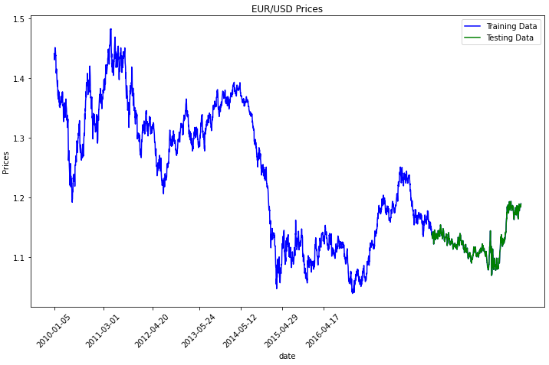
Training & Testing

Slide 7
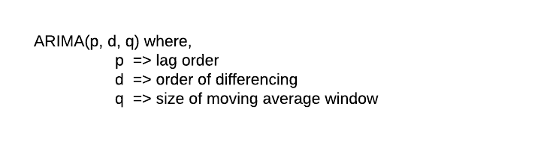
ARIMA Most popular Time Series Forecasting model out there
● (AR) AutoRegressive
● (I) Integrated (d)
● (MA) Moving Arverage (q)

Slide 8
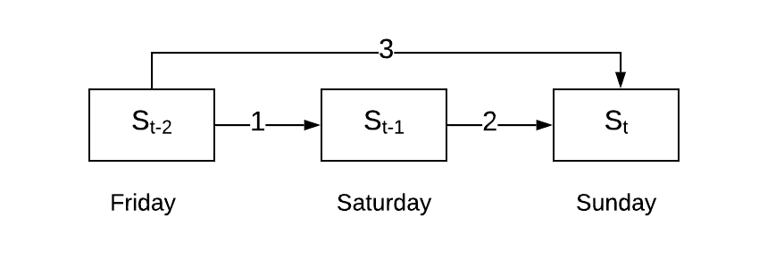
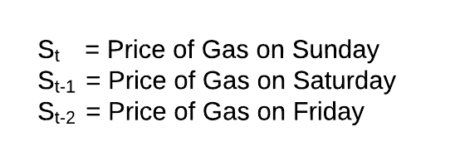
Correlation and Lag Factor Let’s consider an example of predicting the price of gas at any particular day, say Sunday. It’s obvious and easy to think of, that Sunday’s price will be dependent on Saturday’s price.
● Correlation (positive, negative)
● Auto-correlation, which considers both direct and indirect effects (illustrated in the diagram below)
● Partial Auto-correlation, which considers only the direct effects like in the figure below

Slide 9
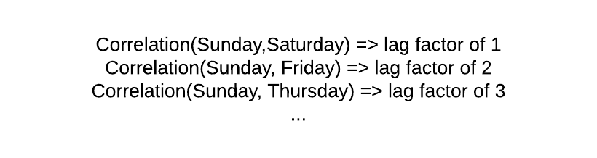
Lag Factor

Slide 10
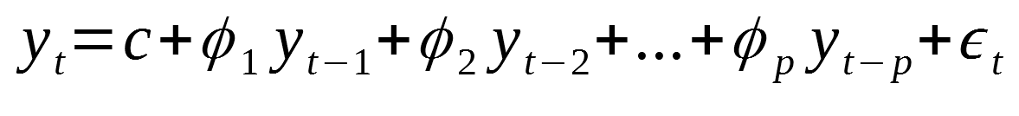
Auto Regressive (AR)
Where:
p: is the order
c: is a constant
epsilon: noise
This (p) is called the lag order. It represents the number of prior lag observations we include in the model i.e. the number of lags which have a significant correlation with the current observation.

Slide 11
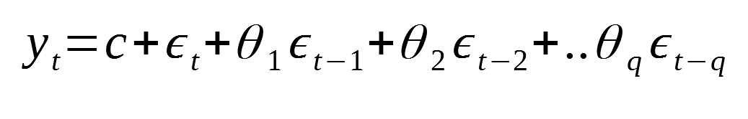
Moving Average (MA)
Where:
q: is the order
c: is a constant
epsilon: noise
(q) represents the size of the moving window i.e. the number of lag observation errors which have a significant impact on the current observation. Its similar to the lag order(p), but it considers errors instead of the observations themselves.

Slide 12
ARMA Then, an ARMA(p,q) is simply the combination of both models into a single equation:
MA model supplements the AR model by taking into considerations, the errors from the previous time-periods thereby helping to get a better estimate.
Hence, this model can explain the relationship of a time series with both random noise (moving average part) and itself at a previous step (autoregressive part)

Slide 13
Stationarity
The models we’ve discussed so far (AR and MA) assume that the series is stationary. This is also means that “stationarity” is a necessary condition to take advantage of these models for any time series.
But…what is Stationarity ?
Basically, for a time series to be stationary, it should satisfy the following 3 conditions…
1. Mean (μ) is constant
2. Standard Deviation (σ) is constant
3. Seasonality doesn’t exist

Slide 14
Integrated (I)
You will came across a lot of series which are clearly not stationary.
Does this mean that forecasting cannot be applied in these cases ?
Well…this is where the sub-acronym I comes in…

Slide 15
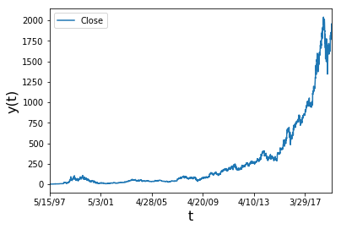
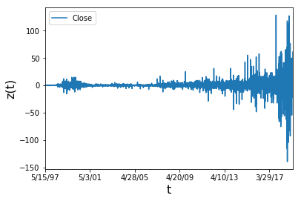

Transformation
Transformation
Amazon stock value over time

Slide 16
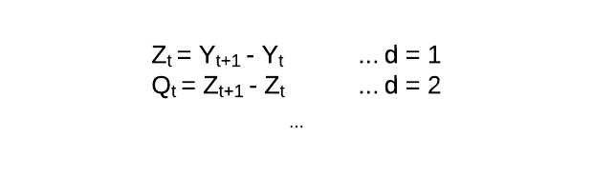
The (d) Parameter This order of differencing (d) is an important parameter of ARIMA and determines the success of the model

Slide 17
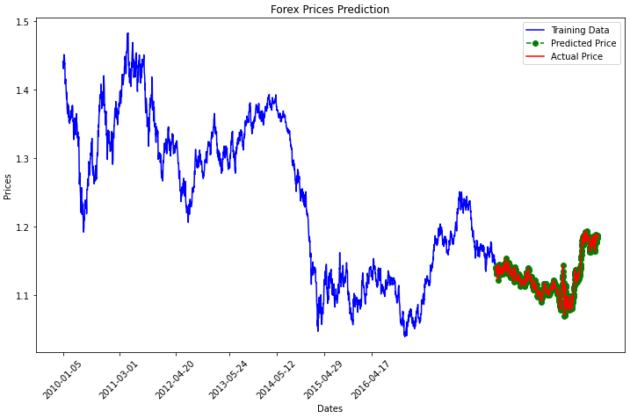
Prediction

Slide 18
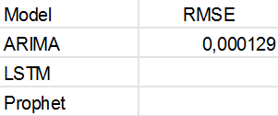
Accuracy

Slide 19
Takeaways
● ARIMA is a widely used forecasting models due to its simplicity and its ability to generalise for non-stationary series.
● Though, it’s important to understand when to use ARIMA and when not to use it. ARIMA doesn’t work well for seasonal type of data. For example, crop yield prediction or sales of Artificial Christmas Trees !
● Its better to use Seasonal ARIMA (SARIMA)in these cases.

Slide 20
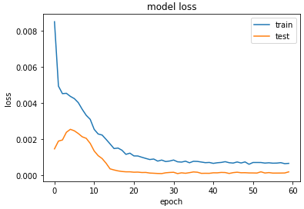
LSTM - Recurrent Neural Networks

Slide 21
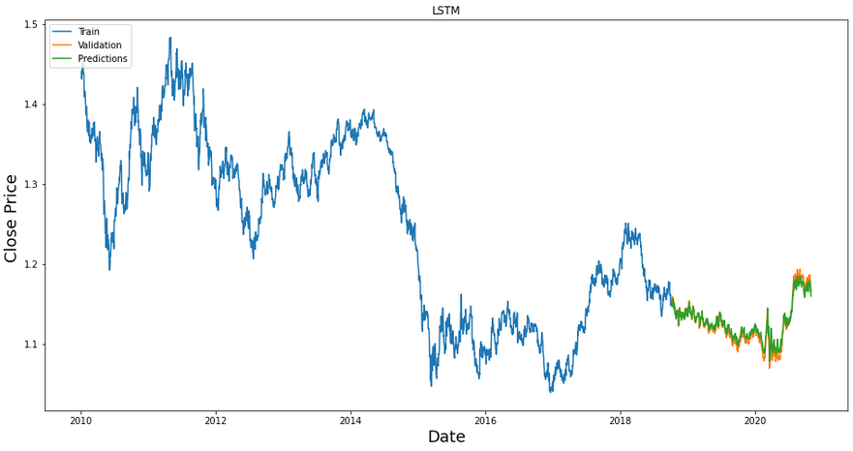
LSTM – Predicting

Slide 22
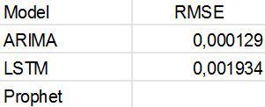
Accuracy

Slide 23
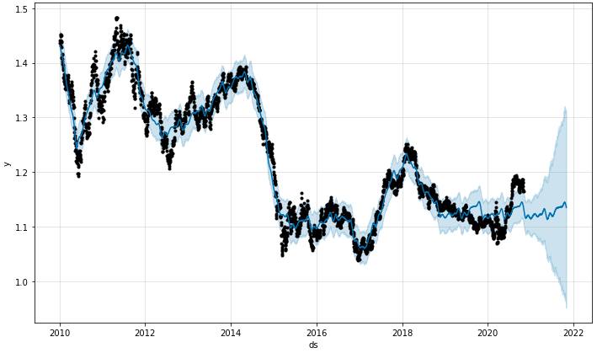
Prophet (by Facebook)
https://facebook.github.io/prophet/

Slide 24
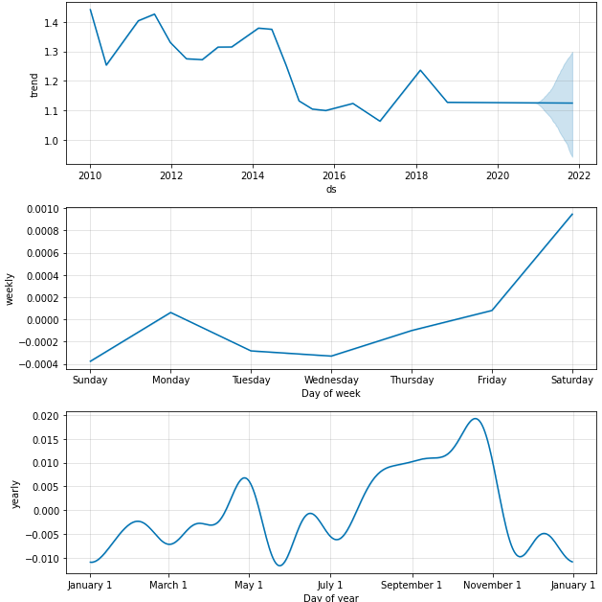
Seasonal Decompose

Slide 25
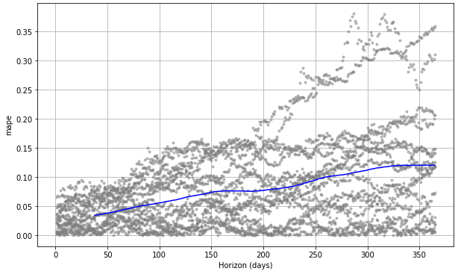
Predicting the Near and Distance Future
Predicting the Near and Distant Future.pdf (mtholyoke.edu)

Slide 26
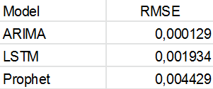
Accuracy

